Slide 1
A DATA STORY ABOUT THE SALES AND RETURN ON INVESTMENT ( R O I ) OF A GIVEN DATA

Slide 2
MONTHS | SALES ($) | ROI (%)
January | 21028 | 13
February | 19451 | 29
March | 20121 | 11
April | 23530 | 24
May | 19935 | 15
June | 22601 | 12
July | 20396 | 27
August | 21460 | 17
September | 19046 | 16
October | 22519 | 15
November | 22696 | 16
December | 18484 | 11

Slide 3
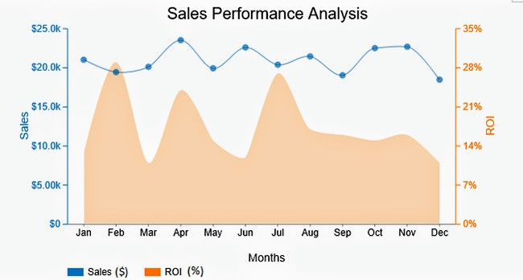
RESULTS
Months | Sales ($) | ROI (%)
Jan | 21028 | 13
Feb | 19451 | 29
March | 20121 | 11
April | 23530 | 24
May | 19935 | 15
June | 22601 | 12
July | 20396 | 27
August | 21460 | 17
Sept | 19046 | 16
october | 22519 | 15
Nov | 22696 | 16
Dec | 18484 | 11

Slide 5
OVERALL SALES TREND
. The sales figure vary throughout the year, with the highest sales in April ($23530) and the lowest in December ($18484).
. There is a noticeable increase in sales from February to April, followed by a slight dip in may, and a more stable performance in the subsequent months.

Slide 6
ROI ANALYSIS
. ROI fluctuates, but generally hovers around 15-17%, with some months experiencing higher ROI (for example February and July).
. The highest ROI is observed in February (29%), indicating a particular profitable month.

Slide 7
CORRELATION BETWEEN SALES AND ROI
. It is essential to investigate if there is a correlation between high sales and high ROI. While April has the highest sales, it also has a relatively high ROI (24%), suggesting efficient resource utilization.

